Slide 1
Majlis Ansarullah
Monthly Meeting
July 2017
This slide deck contains images licensed for the purpose of this presentation only.
No one is permitted to use the images for any other use, without prior permission.

Slide 2
AGENDA
Recitation of the Holy Quran (66:7)
Pledge
Reminders: Recitation of HQ and Congregational Prayers
Monthly topic: Have we tried our best to instill the true Islamic teachings in our children?
Health topic: Influenza
National Reminders/announcements
Local Reminders/announcements
Dua

Slide 3
It’s a blessing to do Waisyat!
In a very special message to members of this Jama’at in 1956, Huzoor^{rz} wrote, “The scheme is already in operation in Pakistan and India. It is my wish and I pray too, that America proves to be the third such country as would adopt this scheme and thus participate very vastly in laying foundations for humanity’s welfare, prosperity and progress. Amen.”
(Tareekh-e-Ahmadiyyat, Vol. 18, pp 104-114)

Slide 4
Why read the Holy Quran regularly?
The Holy Quran gives whatever man wishes for
Hazrat Masih Maud (as) says, “The Holy Quran is wonderful book. The unlettered person, the Holy Prophet (saw) did not only give a Book to the world and taught wisdom, he also made them tread on the path of purification. So much so that they became the recipient of help of God. Behold and ponder over it, the Holy Quran guides every types of man to what he wishes to get from the Almighty God, and quenches the thirst of every thirsty person who is thirsting for Truth.
(Malfoozat Vol.1, page 117)

Slide 5
Watching Our Congregational Salat!
Congregational Prayer is Obligatory for Men
Congregational Prayer is obligatory for men. If those who come to mosque regularly are supportive to others, things could improve. Hazrat Musleh Maud(ra) said that once he came for Isha Prayers and saw only two rows. He suggested to people to bring their neighbors along next time. The number of worshippers started increasing from the next day. Indeed reminding polishes one’s capacities. If people who regularly came for Prayers brought their acquaintances and friends along and shared rides, things could improve.
(Friday Sermon of Hadhrat Khalifatul Masih V (ABA), January 30, 2015)

Slide 6
Have we tried our best to instill the true Islamic teachings in our children?

Slide 7

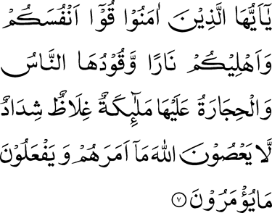
Click to listen the recitation
[66:7] O ye who believe! save yourselves and your families from a Fire whose fuel is men and stones, over which are appointed angels, stern and severe, who disobey not Allah in what He commands them and do as they are commanded.

Slide 8
What does this verse teach us about trying our best to instill true Islamic teachings in our children?
Share your thoughts

Slide 9
Guidance from the Holy Prophet (saw)
Holy prophet (saw) said “ There is not better and superior present that a father can give to his children than cultivation of good morals”
( Tirmidhi)
The Holy Prophet (saw) said: “Respect your children and give them the good moral training.”
(Ibni Majah)

Slide 10

Discussion I
It is Fajr time and your son (above the age of 10) is not waking up. This is the fifth Fajr in a row that he has not woken up. You’ve called the Adhan in his room and sprinkled water in his sleepy eyes. You checked his smartphone and noticed that he had been playing Minecraft with his friends up until midnight. You have explained to him MULTIPLE times in the past weeks that he must wake up for Fajr and he must put the phone away by 10pm to which he agreed.

Slide 11
  Option 1: Take away his smartphone. Use physical force, if necessary, in the case he refuses to hand over the phone.
  Option 2: Explain to him again that he must wake up for Fajr and stop using the smartphone after 10 pm. Convey this same message daily until he changes his lifestyle.
  Option 3: Your daily reminders are not working. Resort to improving the quality of your own prayers.
  Option 4: any other response

Slide 12
Guidance from the Promised Messiah (as)
Promised Messiah a.s. said, “As for me, beating of the children is an act which can be termed as a sort of Shirk (associating others with. God). It actually means that the ill-tempered person makes himself a partner of God in giving guidance and sustaining the creatures. When a quick tempered person punishes someone, he gets so much excited that he turns himself into an enemy and administers punishment many times more than the offence calls for. Only such a person has the right to punish the child to a certain extent, as maintains self respect to control himself and is forbearing and dignified; such a one can scold the child. But he who is quick tempered, undignified and lacking in wisdom has no right that he should be entrusted the duty of upbringing and training the children. I wish that the people could pray for the children just as they are anxious to punish them. They should make it part and parcel of their duties that they pray for the children fervently; the prayers of the parents for their children are particularly accepted by God.”
Malfoozat, Vol II, page 4

Slide 13
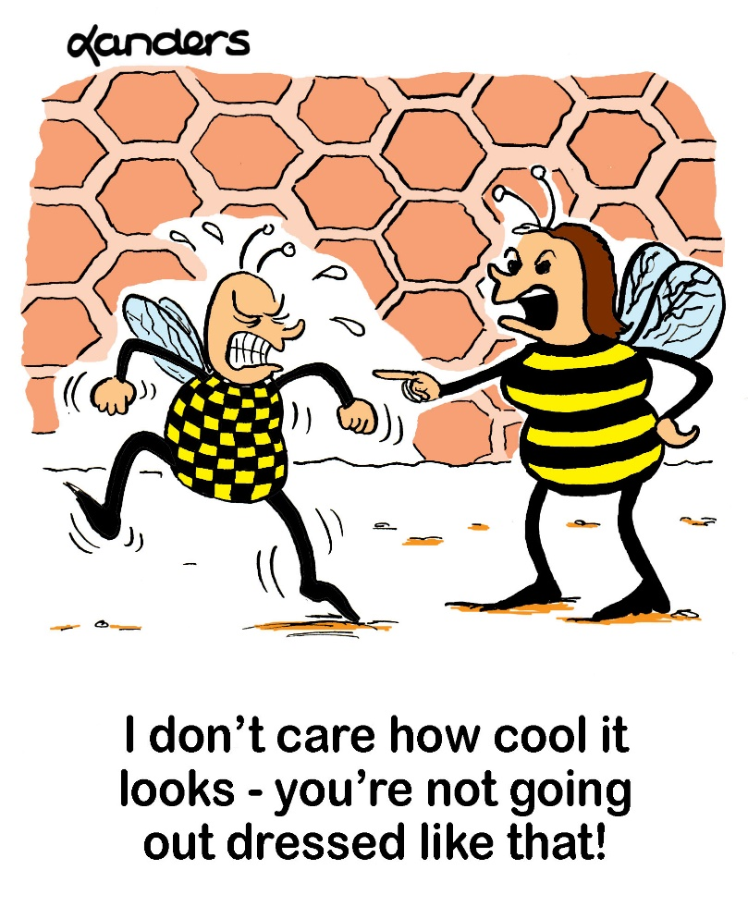
Discussion II
A father confides in you that his daughter is 14 years old and she still has not adopted the Muslim style of dress in high school. She doesn’t cover her head or even wear a scarf. The father complains that in the warmer months, she even wears skirts and shorts that are above her knees. The father and his wife have explained to her many times that this type of dress is not Islamic.

Slide 14
  What’s the best approach?
  Option 1: Advise him to pray for her more fervently. Offer nawafil prayers and fast.
  Option 2: Discard all the clothes that are not appropriate for Muslim girls.
  Option 3: Advise the father to have his daughter homeschooled.
  Option 4: any other response.

Slide 15
Guidance from Promised Messiah (as)
Promised Messiah (as) said about gradual training, “You should wake up at night and pray to God that He may guide you onto the path that leads to Him. The Companions of the Holy Prophet (saw) also had a gradual training. What were they in the beginning? They were like seeds sown in the earth. Then the Holy Prophet (saw) watered and prayed for them. The seed was good and the soil was also good. The watering (by the. Holy Prophet (saw)) produced very good fruit. Just what the Holy Prophet did they followed him and did the same. They never waited for the day or the night. You people should repent sincerely, wake up for Tahajjud prayer, pray and set your hearts right. You should do away with your shortcomings and make your words and actions in complete conformity with the will of God. You should remember that he who will keep this advice in view all the time and will pray in a practical manner and put his needs before God, will be blessed by God and he will find a change (for the better) in his heart. Do not be despaired of God.
(Malfoozat Vol. 1, p. 44)

Slide 16
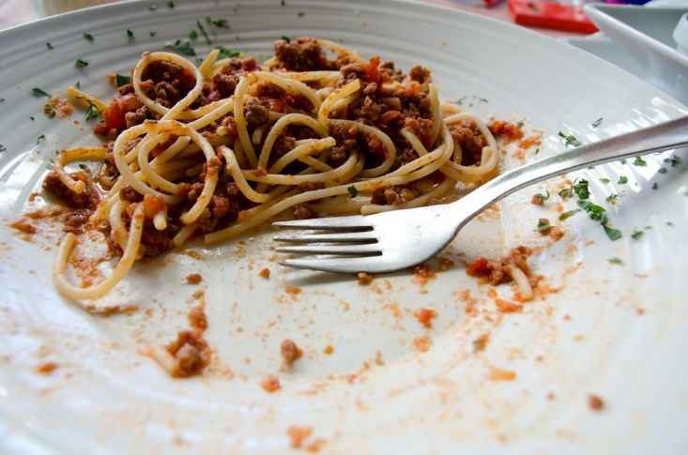
Discussion III
Your 7-year old daughter has not finished her dinner, which is normally what happens. Whatever food your wife puts on your daughter’s plate, your daughter manages to not finish it. You’ve reminded repeatedly your daughter about the blessings of the last morsel of food on the plate. However, your wife is not so strict in reminding the children about this.

Slide 17
  What’s the best approach?
  Option 1: Tell your daughter that she cannot leave the dinner table until her plate is clear.
  Option 2: Reprimand your wife for not taking better care in teaching the children proper Islamic etiquettes.
  Option 3: Be an example for your children. Show them your dinner plate each night and how cleanly you have finished your meal.
  Option 4: Another option?

Slide 18
Guidance from Khalifatul Massih IV (ra)
In a Friday Sermon delivered on 19th December 1986, Hadhrat Khilafatul Masih IV r.a. said, “Parents with great zeal and intelligence should take interest in their children during these years (4-7 years). If you want to inculcate the love of Salat in them then if the children see their parents prepare for Salat, care to offer Salat with proper etiquettes then right from the start prior to them going to school they would develop love for offering Salat and if they see other good manners in their parents then love for those manners will take place in them.”
(pages 843-844, Khutabat-e-Tahir, volume 5)

Slide 19
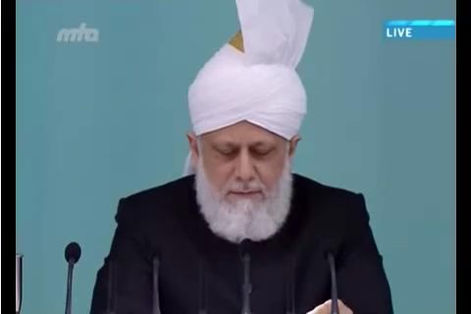
A Short Video from Friday Sermon, Nov. 14, 2014

Slide 20
Translation of the Video
Hazrat Musleh Maud (ra) wrote about an incident. By relating this incident, he brought our attention to the point that Muslim youth should be aware of Islamic morals and etiquettes. He stated in one of his Khutbas, ‘My observation is that there is no attention towards teaching Muslim youth about Islamic customs. Young men casually walk with their arms around each other’s necks, and they don’t even hesitate to practice this in front of me because they have no realization that this is a bad habit. Their parents and teachers have never given any attention to reform their habits even though, these things [early training] can deeply affect human life. I have seen that some people’s early training have effect on my life even today and when I remember such incidents, prayers for them come out of my heart. Once, I was standing with my elbow on the shoulder of a boy, and Master Qadir Buksh Sahib who was the father of Abdur Rahim Dard Sahib, forbade me from this telling me that it is a very bad habit. At that time I was around the age of 12 or 13 years but whenever I remember the incident, my heart fills with prayers for him. Similarly, there was a Subaydar Sahib from Murad Abad. I remember one of his incident as well. My mother is from Delhi and in Dehli as well as in Lakhnow, people use ‘Tum’ (informal ‘you’) to address others. Although, for elderly, ‘Aap’ [respectful ‘you’] is used but because there was no such opportunity for me to learn that as there was no elderly from my mother’s family around Qadian whom she could address with ‘Aap’. Therefore, I used to address Hazrat Massih Maud (as) with ‘Tum’ until the age of 10 or 11 years. May God grant Subaydar Muhammad Ayub Sahib, the highest station in heaven. There was a court case in Gurdaspur and I addressed the Promised Messiah (as) with ‘Tum’ while talking. Subaydar Sahib took me aside and told me that ‘you are the son of the Promised Messiah (as) and therefore respectful for us, but remember that the word ‘Tum’ is used for people with similar status and not for the elders. And for Hazrat Promised Messiah (as), I cannot tolerate the use of this, at all’. This was the first lesson he gave me about this.”

Slide 21
Where do we stand?
اپنے جائزے لیں
Self analyze yourself, KMV
During the last week,
How many times did you reward or appreciate a child or grandchild for behaving well at home.
How many times did you talk to your child or grandchild on misbehaving at home?
How many times did you offer Tahajjud prayer for your child or grandchild?
Add the three numbers together.
(Keep it to yourself.. the “score” is for you!)

Slide 22
How to Improve?
اپنے اندر پاک تبدیلیاں پیدا کریں
Bring about pious changes in yourself
0-1
Combined Score
>7
Strive hard and start praying Tahajjad regularly for your children. Try to teach them manners with love and affection.
Keep enhancing your standards of prayers and spend more and more time with them making them friends.
Continue to offer Tahajjad prayers for your children and keep inspiring them with your role model.

Slide 23

Health Topic: Influenza

Slide 24
What is Influenza?
Influenza is a viral infection that attacks your respiratory system
Influenza resolves on its own in most cases but sometimes influenza and its complications can be deadly in certain high risk groups
People at higher risk of developing flu complications include
Young children under 5, and especially those under 2 years
Adults older than 65
Residents of nursing homes and other long-term care facilities
Pregnant women
People with weakened immune systems
People who have chronic illnesses, such as asthma, heart disease, kidney disease and diabetes
People who are very obese, with a body mass index (BMI) of 40 or higher

Slide 25
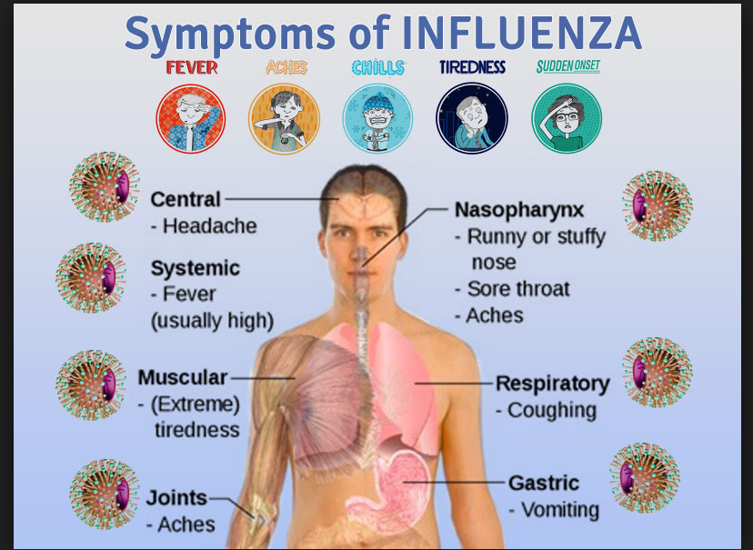
Common Signs and Symptoms

Slide 26
How to prevent Influenza/Flu?
Your best defense against influenza is to receive an annual vaccination. Flu virus changes rapidly and unlike other vaccines, it does not confer long term protective effect. Flu Vaccine is not a booster. It is an entirely new vaccine against new virus given yearly
Drink plenty of liquids - water, juice and warm soups to prevent dehydration
Get more rest and sleep to help your immune system fight infection.
Use acetaminophen (Tylenol, others) or ibuprofen (Advil, Motrin IB, others)
NO aspirin to children under 18, It may result in Reye's syndrome, a rare, but potentially fatal disease
Your doctor may prescribe an antiviral medication, such as oseltamivir (Tamiflu) or zanamivir (Relenza). When taken early, they shorten the duration of illness

Slide 27
Four Priorities for 2017
At least 50% of Tajnid to attend monthly meetings where we discuss Huzoor’s vision: “Save yourself and your families from a fire” in interactive discussions.
Bring 350+ new Ansar in Nazam-e-Wasiyat (The targets for small, medium and Large Majlis are 3, 5, and 7, respectively)
Help establish a culture of congregational Salat.
More than 50% Tajnid to attend National Ijtima.

Slide 28
Local Reminders
Dua

